Slide 1
Antibiotics by clinical case
Budhima Nanayakkara PhB(Hons) MBBS(hons)
PGY2 Canberra Hospital
MRBS

Slide 2
Learning Objectives
Learn classification of Gram-positive organisms
Learn the common antibiotics that are prescribed for diseases caused by common gram-positive organisms
Explain the mechanism of action of beta-lactam antibiotics
Recognise the early warning signs of sepsis and the deteriorating patient through history, clinical signs and observation charts
Understand the importance of early recognition of sepsis, the importance of early antibiotic therapy and the importance of appropriate fluid therapy
Identify that sepsis can lead to multi-organ dysfunction and as a severe cause of morbidity and mortality

Slide 3
Take Home Message
Recognise antimicrobial stewardship as highly important
Know the existence of the therapeutic guidelines and the microbiology registrar
Rapidly recognise a sick patient
Rapidly recognise a patient at risk of sepsis/ severe sepsis or septic shock and refer appropriately

Slide 4
Case 1
Mrs Jones is a 68yo female with poorly controlled type 2 diabetes who is seen in the emergency department. You, the intern covering the night shift, takes a look at her triage notes. Your senior consultant tells you that she should be a straight forward case and you should be able to just send her home.
The triage notes read:
JA, 68yo F presents with sudden onset fevers, chills, nausea and rash on left leg. Stubbed her toe 3 days ago on the left foot. Obs: RR 18, T 38.3, Pulse 68, SaO2 99%, BP 135/85

Slide 5
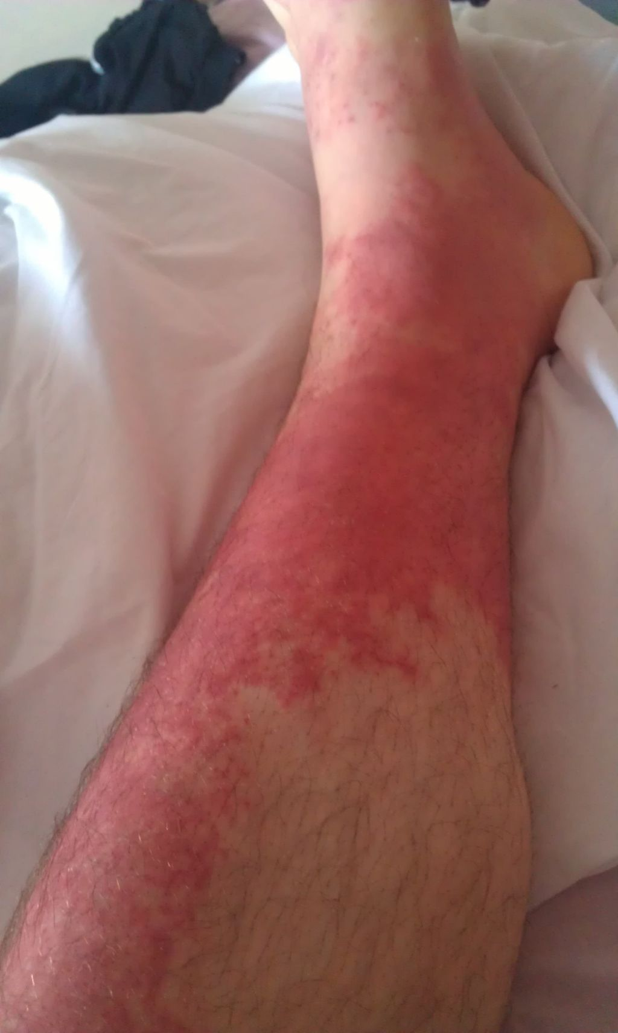

Slide 6
Clinical Diagnosis
What is your interim diagnosis?
What is your differential diagnosis?
What are her risk factors?
Notes:
Cellulitis
Cellulitis, erysiphels, DVT, thrombophlebitis, any other cause of rash – vasculitic rash
Age, diabetes

Slide 7
Case 1 Progression
You run with the likely diagnosis of cellulitis
On physical examination you see a warm, oedematous erythematous leg with good demarcation. There is some blistering. There is an injured left toe. She has full ROM to her knee and ankle. You decide to take some blood samples for investigations. What do you order?
Notes:
FBC, UEC, LFT, CRP, CMP, Coags

Slide 8
UBECX-SPECIAL
U: Urinalysis/ Ultrasound
B: Bloods (FBC, UEC, CMP, LFT, Coags, CRP, Lipase, Trops)
E: ECG
C: Cultures/ Swabs/ aspirations
X – X-rays/ CT
Special: MRI, nuclear medicine etc

Slide 9
Investigations
Hb 130/ WCC 22.3/ N-phils 18/ Pt 458/ CRP 108
Na 138/ K 4.8/Urea 9.6/ Creatine 258/ GFr 32: Earlier Cr 200/ GFr 52/ BGl 10.8
ALT 32/ GGT 40/ ALP 45/ Albumin 25
Lactate 3.6
Wound swab – Gram positive cocci
Interpret the above results
Notes:
Profoud leukocytocis and neutrophilia
Wound – gram positive cocci - ? Source of cellulitis
Acute kidney injury
Hypo-albuminaemia of critical illness (negative acute phase reactant)

Slide 10
Gram positive Organisms
Purpose of gram staining
Purely used as a classification tool
Differentiates into gram positive (uptake of stain) versus gram negative
After gram staining a number of different methods can be used to classify organisms
Don’t worry about these as a JMO

Slide 11
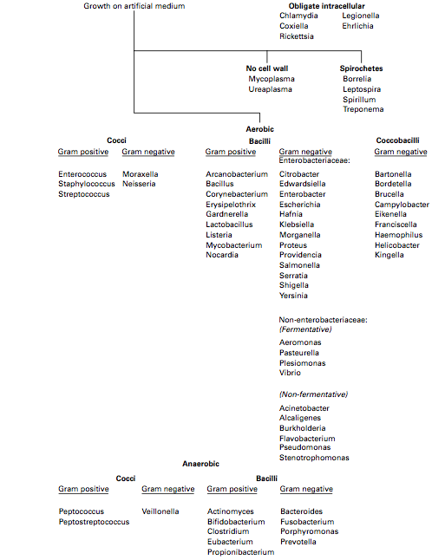

Slide 12
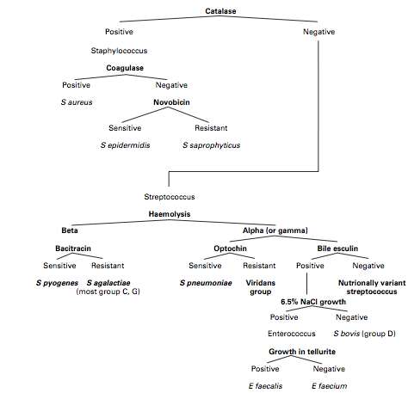
Classification of Gram positive Organisms
Notes:
You need to know the clinically important gram positive cocci and the diseases caused by each as a junior medical officer
Then you need to know roughly what antibiotics covers which infection
Really you do not need to know the specifics, and even if you are full in the know, you should go to the therapeutic guidelines to guide treatment

Slide 13
Important soft tissue infections
Erysipelas
Superficial cellulitis with prominent lymphatic involvement
Caused predominantly by S. pyogenes (Group A Strep)
Painful lesion, bright red, indurated, streaky and well demarcated
Systemic symptoms
Cellulitis
Acute spreading infection of skin, deeper than erysipelas
Caused by S. pyogenes (Group A Strep)/ S. aureus
Local tenderness, pain, erythema. Involved area is often extensive, hot, swollen, local abscesses, blisters can develop
In contrast to erysipelas, lesion not necessarily continuous, not raised and not well demarcated

Slide 14
Question
Can you clinically differentiate between cellulitis caused by Group A streptococci and S. aureus? What is the significance in treatment?
What is the mechanism by which cellulitis may cause death?
Notes:
Rapidity
Treatment differs in choice and duration of antibiotics

Slide 15
Classification of Gram positive Organisms
Notes:
You need to know the clinically important gram positive cocci and the diseases caused by each as a junior medical officer
Then you need to know roughly what antibiotics covers which infection
Really you do not need to know the specifics, and even if you are full in the know, you should go to the therapeutic guidelines to guide treatment

Slide 16
Case 1
Mrs Jones is a 68yo female with poorly controlled type 2 diabetes who is seen in the emergency department. You, the intern covering the night shift, takes a look at her triage notes. Your senior consultant tells you that she should be a straight forward case and you should be able to just send her home.
The triage notes read:
JA, 68yo F presents with sudden onset fevers, chills, nausea and rash on left leg. Stubbed her toe 3 days ago on the left foot. Obs: RR 18, T 38.3, Pulse 68, SaO2 99%, BP 135/85

Slide 17
Investigations
Hb 130/ WCC 22.3/ N-phils 18/ Pt 458/ CRP 108
Na 138/ K 4.8/Urea 9.6/ Creatine 258/ GFr 32: Earlier Cr 200/ GFr 52/ BGl 10.8
ALT 32/ GGT 40/ ALP 45/ Albumin 25
Lactate 3.6
Wound swab – Gram positive cocci
Interpret the above results
Notes:
Profoud leukocytocis and neutrophilia
Wound – gram positive cocci - ? Source of cellulitis
Acute kidney injury
Hypo-albuminaemia of critical illness (negative acute phase reactant)

Slide 18
Case 1
After acknowledging the clinical history (elderly female with immunosupression and preceeding trauma, with rapidity of clinical presentation), the clinical examination (unilateral, erythematous skip lesion rash on lower extremity, haemodynamically stable), the clinical investigation findings (leukocytocis with left shift, evidence of acute phase response and acute kidney injury), you decide to admit the patient for in-hospital management.

Slide 19
Reasons for admission
What are the reasons for admission for this patient? Make an issues list like you would as an admitting medical registrar
Notes:
Cellulitis, un-treated with SIRS
Acute kidney injury
Hyperglycaemia ? Uncontrolled type 2 DM

Slide 20
Issues List
Cellulitis, un-treated with SIRS
Acute kidney injury
Hyperglycaemia ? Uncontrolled type 2 DM

Slide 21
Treatment
You decide to initiate treatment

Slide 22
Approach to treatment in any patient
Initial stabilisation
Triage
Positioning
Airways
Keep patent
Look out for obstruction, loss of airway reflexes, C-spine issues
Treatment: oxygen +/- adjuncts, suctioning, obstruction manouvres
Breathing
Check RR, Sats, cyanosis, breath sounds
Especially look for emergencies – severe asthma, tension pneumothorax
Treatment: oxygen, bag-valve-mask breathing, needle decompression with chest tube insertion
Circulation
PR, BP, Cap-refil, urine output
Especially look for emergencies – acute pulmonary oedema, pulmonary embolism, hypotension
Treatment: IVC x 2, fluid bolus and check responsiveness, cardiac drugs, vasopressors, IDC
Disability
GCS, PEARL
Environment/ Exposure
Temperature
BGL
Expose patient

Slide 23
Take-home Message
Air goes in and out, blood goes round and round

Slide 24
Specific Treatment
Treat the infection
Cellulitis
Treat the hyperglycaemia
Anti-glycaemics
Role of insulin?
Treat the Acute kidney injury
Pre-renal?
Monitor fluids
Renal?
Sepsis
Toxins? GN? AIN? ATN? +++
Post-renal?
Get an US

Slide 25
Antibiotics
Anti-infective agents that are (1) bacteriocidal (2) bacteriostatic or BOTH
MINDME
Microbiology guidelines ALWAYS
Indications should be evidence based
Narrowest spectrum required
Doseage appropriate to the site and type of infection
Minimise duration of therapy
Ensure monotherapy in most situations
Notes:
Eg use antibiotics in acute otitis media – amoxicillin use only relieves symptoms by up to 4 hours maximum, but put patient at risk of C. difficle enterocolitis, AIN, anaphylaxis etc

Slide 26
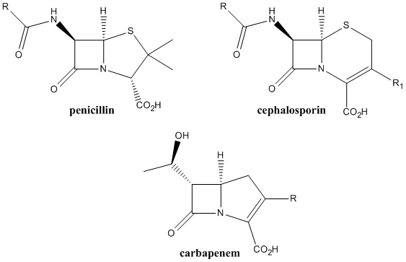
Beta-lactams
Notes:
Mechanism of action: inhibition of cell wall synthesis by inhibiting transpeptidase reaction in the cross-linking of peptidoglycan. Covalent binding at the active site serine residue

Slide 27
Question
What are the classes of penicillins?
What’s the clinically relevant difference between each of these?

Slide 28
Penicillins
Natural penicillins
B-lactam resistant penicillins
Amino-penicillins
Penicillin V
Penicillin G
Diclox/ fluclox
methicillin
Amoxicillin
ampicillin
Carboxy-penicillins
ureidopenicillins
ticarcillin
piperacillin

Slide 29
Natural Penicillins
Clinically relevant: Penicillin V, Penicillin G
Penicillin V acid labile = oral use
Penicillin G (AKA benzyl penicillin)= IV use
Most active against non Beta-lactamase producing gram positive organisms, anaerobes and some gram negative cocci
Therefore clinically, used mainly for gram positive cocci that are not staphylococci

Slide 30
Aminopenicillins
Amoxicillin/ Ampicillin
Extends into enterococcus cover
Gram negative cocci cover
Not good gram neg rod cover unless add on beta-lactamase inhibitor (Augmentin DF)

Slide 31
Carboxypenicillins and Ureidopenicillins
Include ticarcillin and piperacillin
Broad spectrum, against gram positive, gram negative and anerobes
Anti-pseudomonal
NOTE: Broad spectrum does NOT equal better efficacy
Eg MIC for Piperacillin > penicillin G for S. pneumoniae, S. pyogenes, S. agelectiae, viridans group Strep

Slide 32
Note about S. aureus
S. aureus is either beta-lactamase producing or non-producing. Only 5% of isolates are non-producing
Non producing beta-lactamase isolates are highly susceptible to naturally occuring penicillins (once the culture result comes back, convert to these, as they have a very low MIC)
Beta-lactamase producing can either be methicillin resistant or methicillin sensitive
Methicillin sensitive (MSSA) are sensitive to beta-lactam resistant antibiotics
Fluclox/ diclox
MSSA are also sensitive to cephalosporins (clinically same for each generation of cephalosporin)
They are not sensitive to natural penicillins, carboxypenicillins or ureidopenicillins
You CAN USE semi-synthetic penicillins (Diclox/ fluclox)
Methicillin resistant (MRSA) are resistant to all beta-lactam structured antibiotics

Slide 33
S. Aureus
5% Beta-lactamase non-producers
- Use naturally occurring penicillin's
95% beta-lactamase producers
MSSA
- diclox/ fluclox + cephalosporins
MRSA
- No B-lactams

Slide 34
Question
Your lab has just informed you that you are growing gram positive cocci. The cocci are catalase positive, coagulase positive. Testing for oxacillin (methicillin) shows that it is sensitive and produces beta-lactamse. What antibiotics would be beneficial
Tazocin 4.5g TDS IV
Ampicillin 1g QID IV
Cephalexin 500mg TDS PO
Ceftriaxione 2g daily
1.2g bezylpenicillin
Dicloxacillin, 500mg QID

Slide 35
A note on pharmocokinetics and pharmacodynamics
Penicillins differ markedly in oral absorption.
Many are acid labile
Penicillin G
Piperacillin
Ticarcillin
Penicillins are mostly excreted unchanged, rapidly. They are actively secreted by renal tubular cells, hence the addition of probenecid which blocks tubular secretion of organic anions prolongs half life
Renal excretion of all penicillins is markedly less in new-borns because of immature tubular function
Penicillins are well distributed to most tissue. The levels of penicillins in abscesses are sufficient in presence of inflammation, but distribution to brain, CSF is nil in absence of inflammation
These drugs are AUC dependent kill, as opposed to concentration dependent kill (aminoglycosides)

Slide 36
MRSA
Acquired a new penicillin binding protein
There are no beta-lactam antibiotics that can kill it
Requires other use
Differentiated again into multi-resistant and non-multi-resistant
Non multi-resistant is often community acquired
Treat with clindamycin, co-trimoxazole and tetracyclines
For multi-resistant strains from hospital
Treat with vancomycin, fusidic acid and rifampicin

Slide 37
Case Continued
You decide to continue with your treatment. For the acute kidney injury you (a) get a renal US and obtain urine Protein/ creatinine and active urinary sediment samples. You also give this patient some IV fluid therapy, aggressively initially. You put in an IDC to monitor fluid input/ output accurately
For her hyperglycaemia, you decide to aim for BGL <10, and put in an insulin sliding scale. You aim to have the endocrine team review her requirements later on
For her skin infection, you decide to initiate IV antibiotic therapy
For her general health, she requires hospital admission

Slide 38
Case Continued
She has cellulitis. Given the rapidity of her symptoms, you suspect S. pyogenes. You look at the therepeutic guidelines…

Slide 39
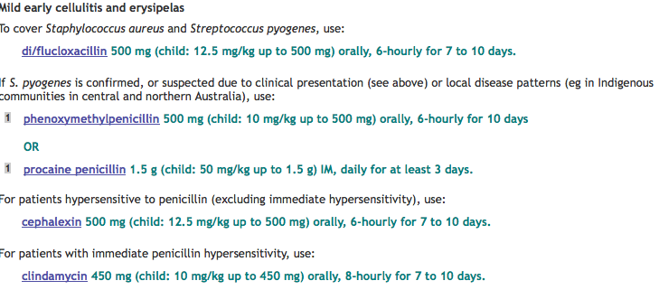

Slide 40
Question
What is the percentage of people, who have an allergic reaction to penicillin, that are also sensitive to other beta-lactams?
Notes:
10%
If immediate hypersensitivity, cannot use any beta-lactam antibiotic

Slide 41
Case progresses
You are sitting down pondering your optimal antibiotic choice. IT is about 30 minutes to handover and the thought of a kangaroo steak looms in the background. The nurse looking after your patient calls you in. Doc, this patient is sea-gulling, blood pressure is quite low and she is tachycardic. She hasn’t made any urine in the last 4 hours. I have taken the liberty of doing a blood gas aswell. She seems a bit drowsy. I know that you have told me to give the fluids and both bags have now finished, but her blood pressure is still quite low. I am worried about this patient. Please come and see her immediately

Slide 42
Question
Is this patient sick?
What are the critical elements of her history that makes her sick?
Do you have any idea of what is happening?

Slide 43
Blood Gas
pH 7.23 (7.35 – 7.45)
pCO2 40 (35 – 45)
pO2 90 (60 – 100)
HCo3 12 (10)
BE -8.6 (-3, +3)
Lactate 6.8
Notes:
Metabolic acidocis (a component of which is likely lactic acidocis) with concomitant respiratory acidocis

Slide 44
Sepsis, SIRS, Severe Sepsis and Septic shock
It is not the fall that kills you, it is the landing…
SIRS (systemic inflammatory response syndrome)
Temp >38 or <36
HR >90
RR > or PCO2 <32
WCC >12,000or leukopenia (<4000)
Sepsis = SIRS + infection
Severe sepsis = Sepsis + evidence of end-organ dysfunction
Septic shock = severe sepsis with hypotension/ hyperlactatemia not responding to adequate fluid resuscitation

Slide 45
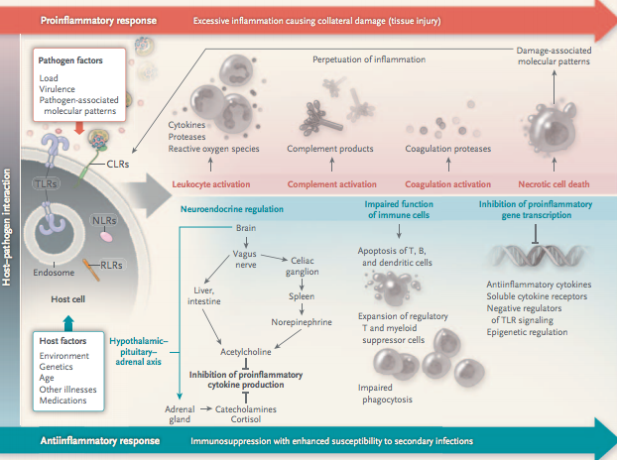

Slide 46
Multi-organ dysfunction syndrome (MODS)
Two or more organ systems fail sequentially or at same time in patient with severe sepsis
Pathophysiology is complex
Cytopathic hypoxia (cannot utilise oxygen)
Take-over of anti-inflammatory response with T/ B cell apoptosis
Microvascular thrombosis
DIC

Slide 47
Name some physiological markers of MODS?
Lung?
Liver?
Kidney?
Brain?
Heart?

Slide 48
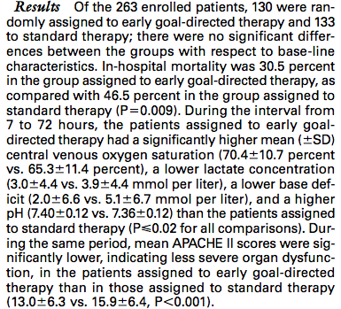
Notes:
Not a multi-centre study

Slide 49
Take Home Message: Early Recognition and action saves lives in Sepsis

Slide 50
But is this the full story…
Introducing NEJM 2014…

Slide 51
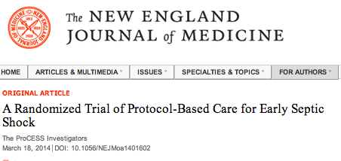
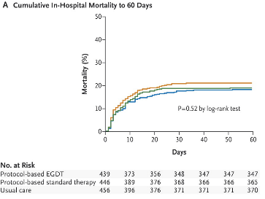
Notes:
Multicentre trial after the rivers trial
31 hospitals in the united states

Slide 52
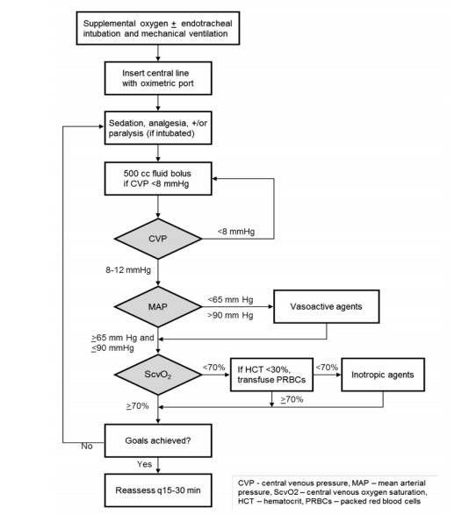

Slide 53
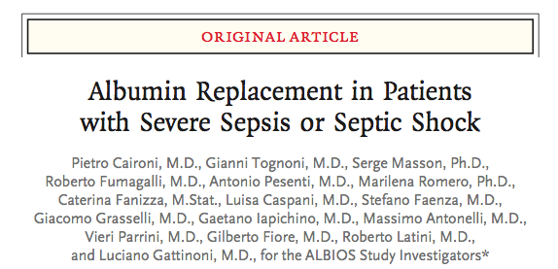
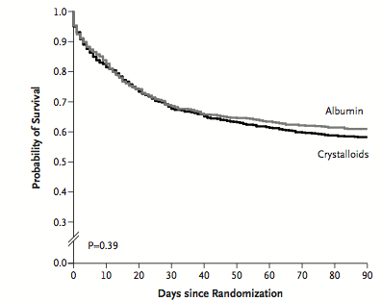
Notes:
Multicentre trial, over 100 ICUs enrolled
Albumin + crystalloid versus crystalloid alone
Primary outcome was 28 day mortaility, secondary was 90 day mortality from sepsis/ all cause outcomes.
No significant difference

Slide 54
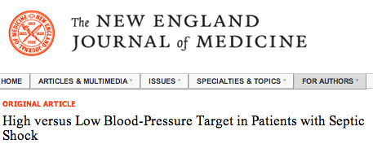
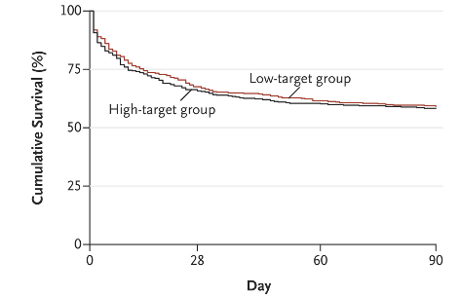

Slide 55
Take Home Message 2:
Albumin not helpful in septic shock patients
Early goal directed therapy not proven to be effective in large multi-centre trials
Aiming for higher arterial pressures not associated with mortality benefit, but for subgroup of patients who had chronic arterial hypertension, whilst there was no mortality benefit there was a lesser requirement for renal replacement therapy

Slide 56
Case progression
Unfortunately, this patient tells you that she had a rash when she used penicillin for strep throat once. She is however adamant that this was not an anaphylactic reaction.
Question: What class of antibiotics are the cephalosporins?
Notes:
Beta-lactam

Slide 57
Cephalosporins
Divided in generations
First generation (cephalexin, cephazolin)
Great coverage of Strep and staph and MSSA
Poor coverage of penicillin resistant S. pneumoniae
Poor coverage of H. influenzae/ M. cattarhalis
Medium coverage of E. Coli, Klebsiella
Poor coverage of other gram neg rods
Second generation (Cefuroxime)
Great coverage of strep and staph and MSSA
Poor coverage of penicillin resistnt S. pneumoniae
Good coverage of H. influenzae and M. catarrhalis
Good coverage of N. meningitidies and N. gonorrhoea
Medium coverage of enteric gram neg

Slide 58
Cephalosporins
Third Generation (Cefotaxime/ Ceftriaxone)
Excellent cover against Strep/ Staph (MSSA), although not as good for MSSA as earlier gen cephalosporins
Excellent cover against Gram neg cocci (Neisseria/ Haemophillus/ Moraxella)
Excellent cover against gram neg rods except P. aeruginosa, where ceftazidime has good coverage
Poor coverage of bacteroides (anaerobic gram negative rod)
Fourth Generation (Cefepime)
Excellent gram positive, gram neg cocci, gram neg rods (including P. aeruginosa, excluding B. fragilis)
MRSA active
New chemicals
Include ceftraroline and ceftobiprole

Slide 59
Cephalosporins
Shit activity against mycoplasma, chlamydia and listeria

